Slide 1
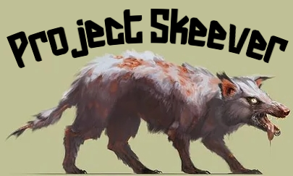
SA Demo

Slide 2
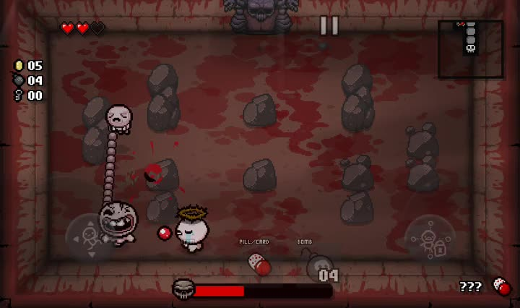

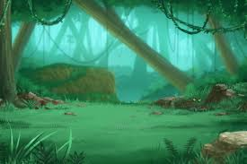
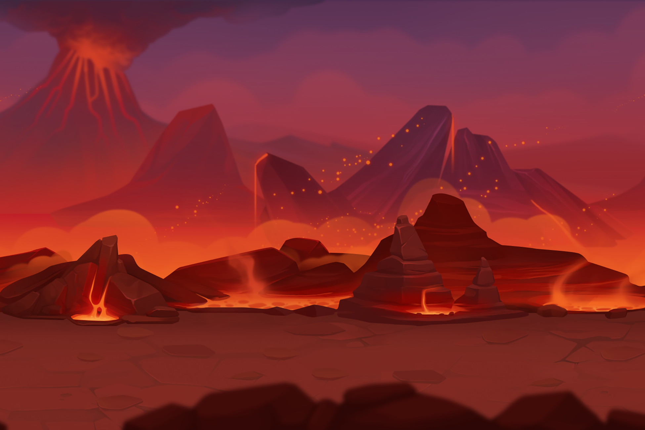
Fiasco
The new hottest game on the market
2D, top-down design
Bullet hell combat style
Island setting
Intriguing (but non-intrusive) story
Bullet hell stylistic example: The Binding of Isaac
Three levels: beach, jungle, volcano
Play as a shipwrecked hero
Utilize a variety of weapons and items
Fight your way through swarms of diverse enemies to reach the volcano and complete your quest
Move inland to complete your quest and beat the game!

Slide 3
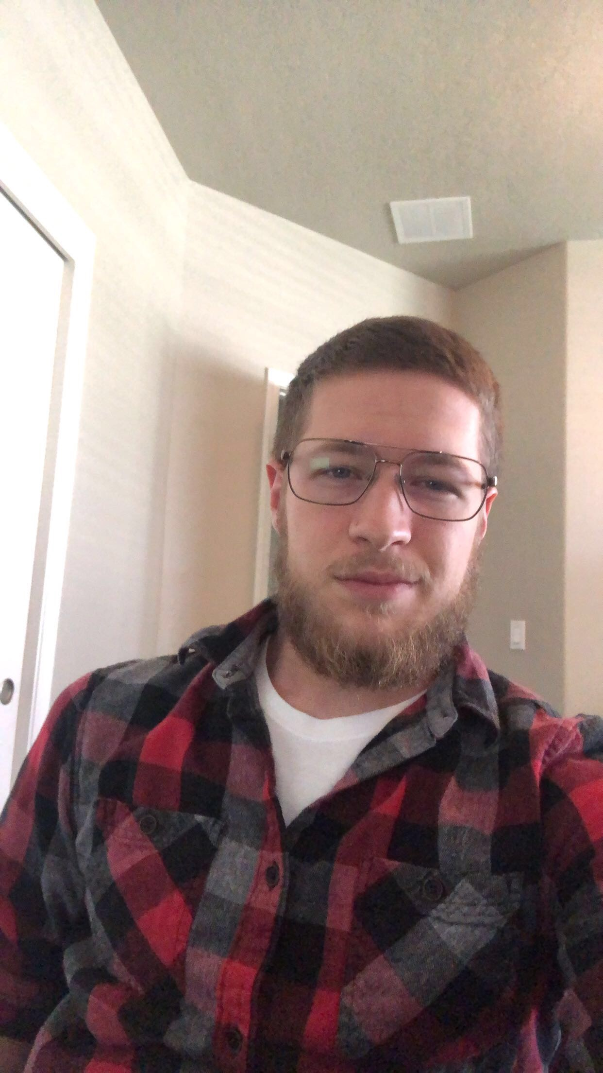

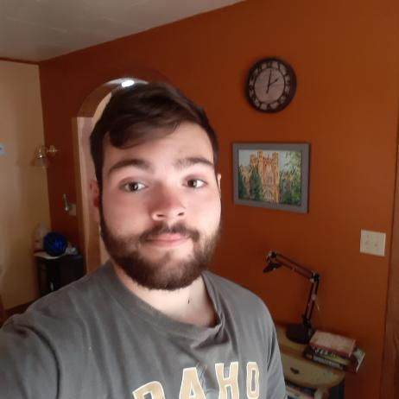
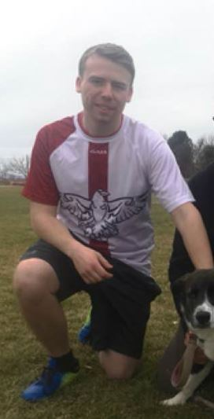
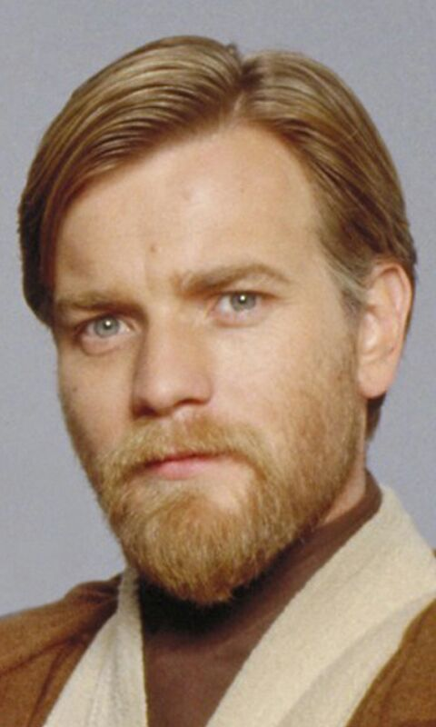

Meet the Team
Seth
Team Lead 1
UI Design
Taylor
Team Lead 2
Environment Design
Zach
Team Lead 3
Character Design
Winston
Team Lead 4
Enemy Design
Max
Team Lead 5
Combat and
Projectiles
Greyson
Team Lead 6
Pathfinding and
Sound Design

Slide 4

Storyboard – Start Screen
Action: Player selects button to either start the game, adjust settings, or read help docs
Fiasco
Start
Options
Help
Notes: The start screen is fairly simple. It consists of a button to start the game, an options button to adjust audio settings and difficulty, and a button that displays a detailed help screen that explains the controls, all set against an aesthetically pleasing pixel art background.
Notes:
https://itch.io/t/336427/release-tropical-island-sunset-pixelart-background

Slide 5


Storyboard – Game Intro
Action: At the start of the game, the player finds a scroll on the beach
Dialogue: The scroll contains a message that explains the premise of the game
Greetings, Wayfairer-
If you have found this note, then you are the next of our wretched line to lie cursed upon the coast of Fiasco Isle. You must try—as hundreds of us have, over hundreds of lifetimes—to overcome the cruel inhabitants of this island and carry our torch into the volcano's flames. You must accept this task, lest you perish on the sand.
Fight well with the weapons and items of the island, lest you perish in the jungle.
Beware of Kobul-tal, the Flesh-Eater, who has bested a thousand hunters in a thousand lifetimes, lest you perish on the volcano's slopes.
Fight well, that you may bring rest to all our souls.

Slide 6
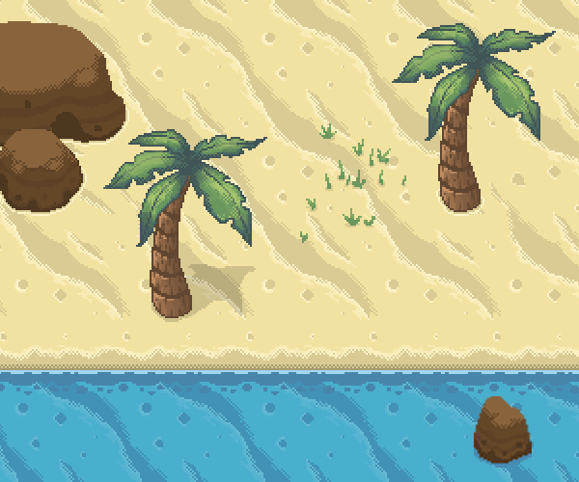

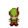
Storyboard – Beach Level
Action: After reading the note, the player moves up the beach towards the jungle, fighting enemies along the way

Slide 7
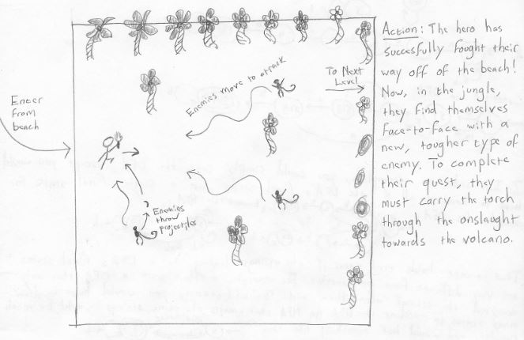
Storyboard – Jungle Level

Slide 8
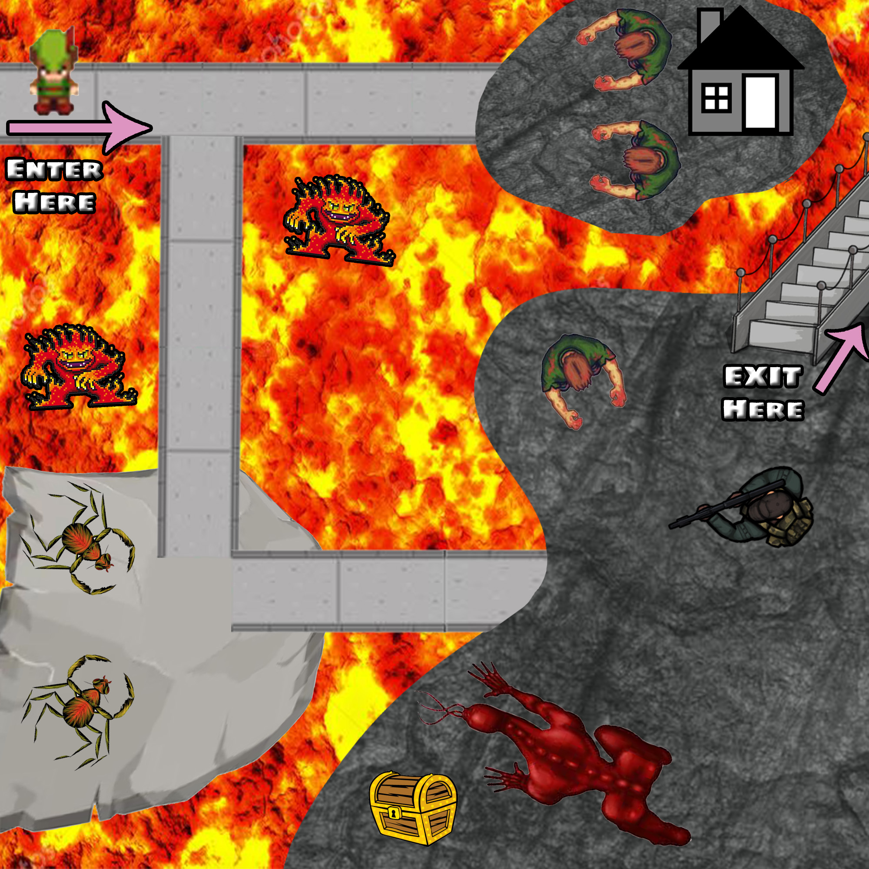
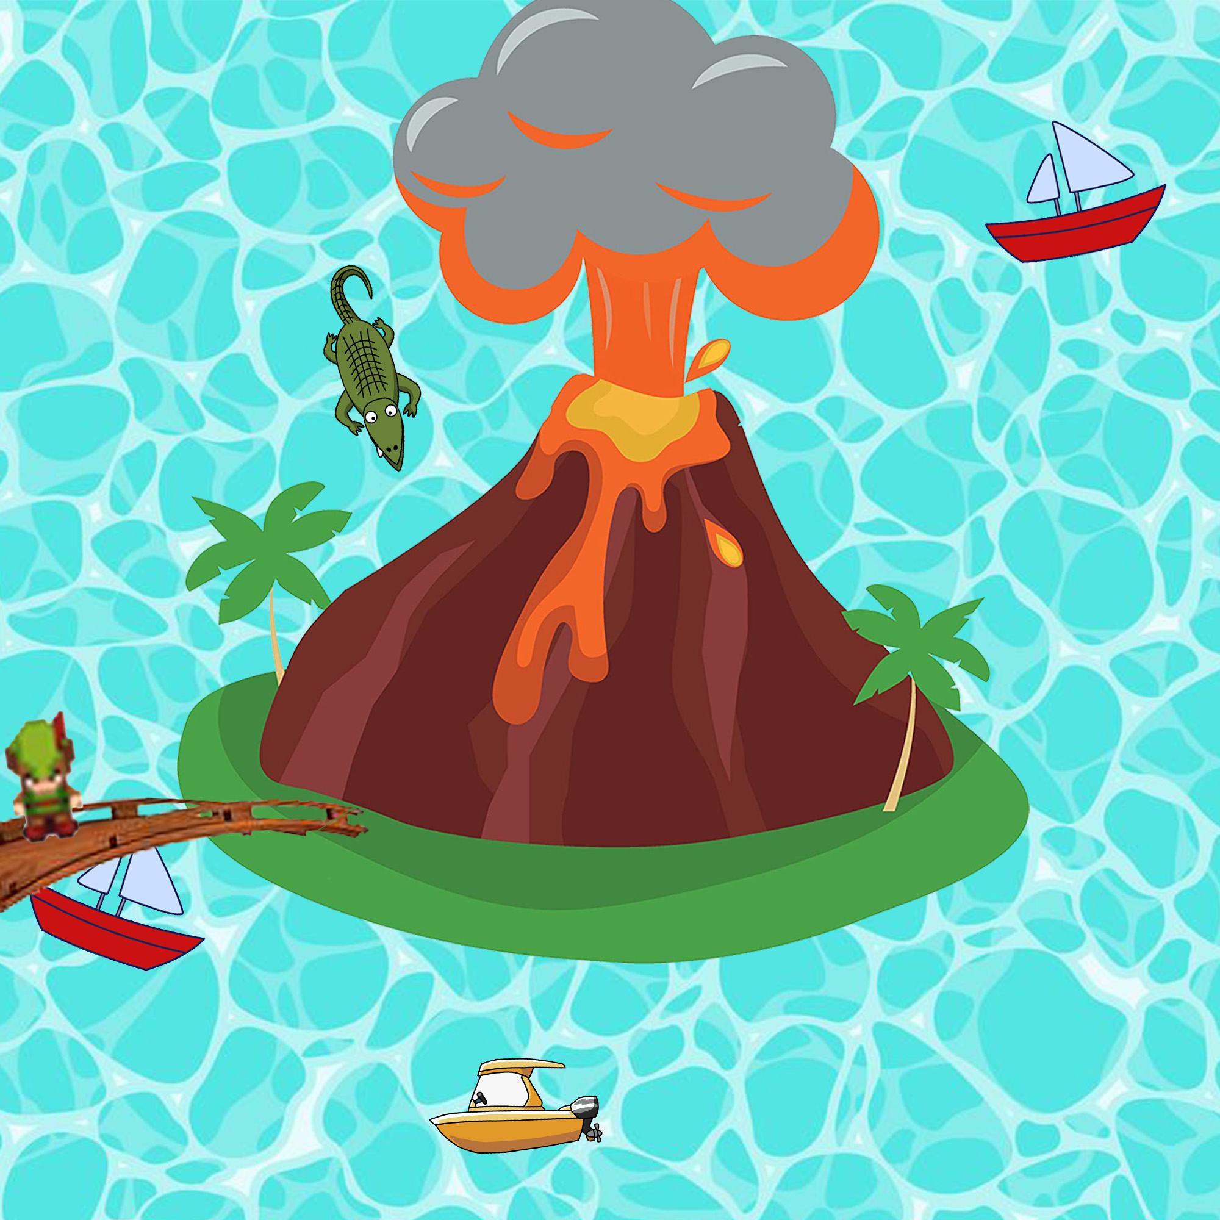
Storyboard – Volcano Level
Action: Now that the hero has consequered the jungle, it's time for them to enter the volcano. Once they enter, they'll find a multitude of even more difficult enemies that they must fight in order to move on. At the end of this scene, they'll find a new weapon in a chest, which they will use to defeat the final boss. When they've completed this scene, they'll walk up the stairs towards the top of the volcano.
View from outside the volcano
Inside the volcano

Slide 9
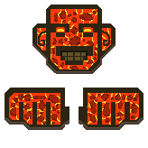
Storyboard – Final Boss
Action: You enter the volcano to come face to face with a giant volcano tiki god, with torch in hand you battle it out with him. When he throws his molten lava fists you dodge and hit his face with your attack. Once you defeat him you have won

Slide 10
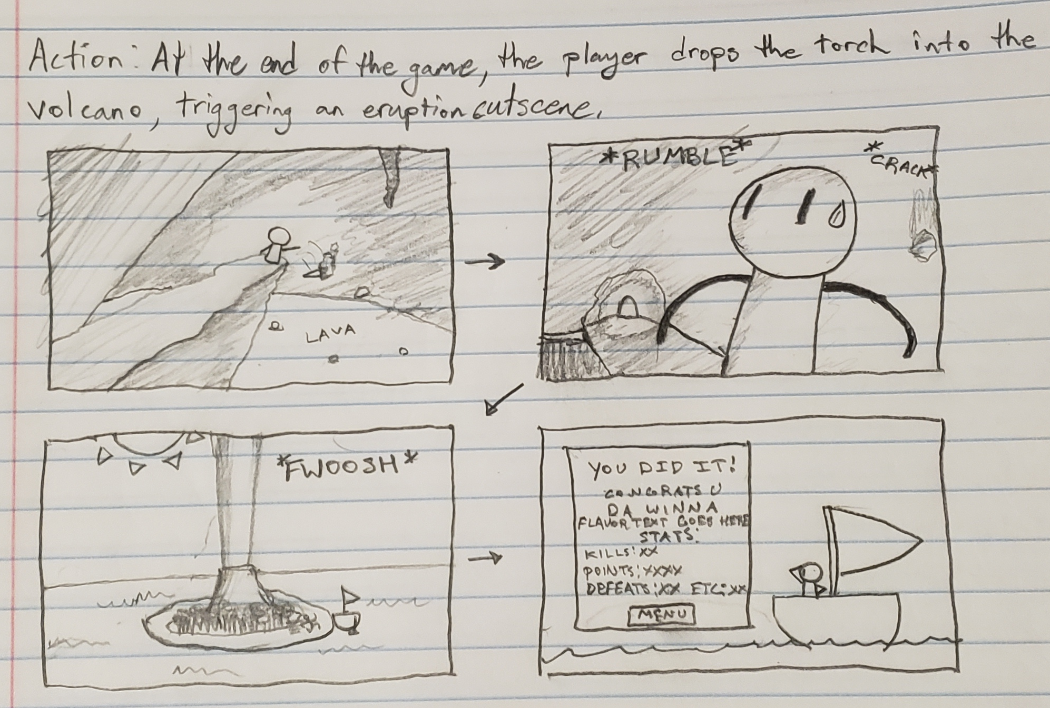
Storyboard – Victory Scene

Slide 11
Context Diagram
0
Player input
Player
Output to terminal
Fiasco

Slide 12
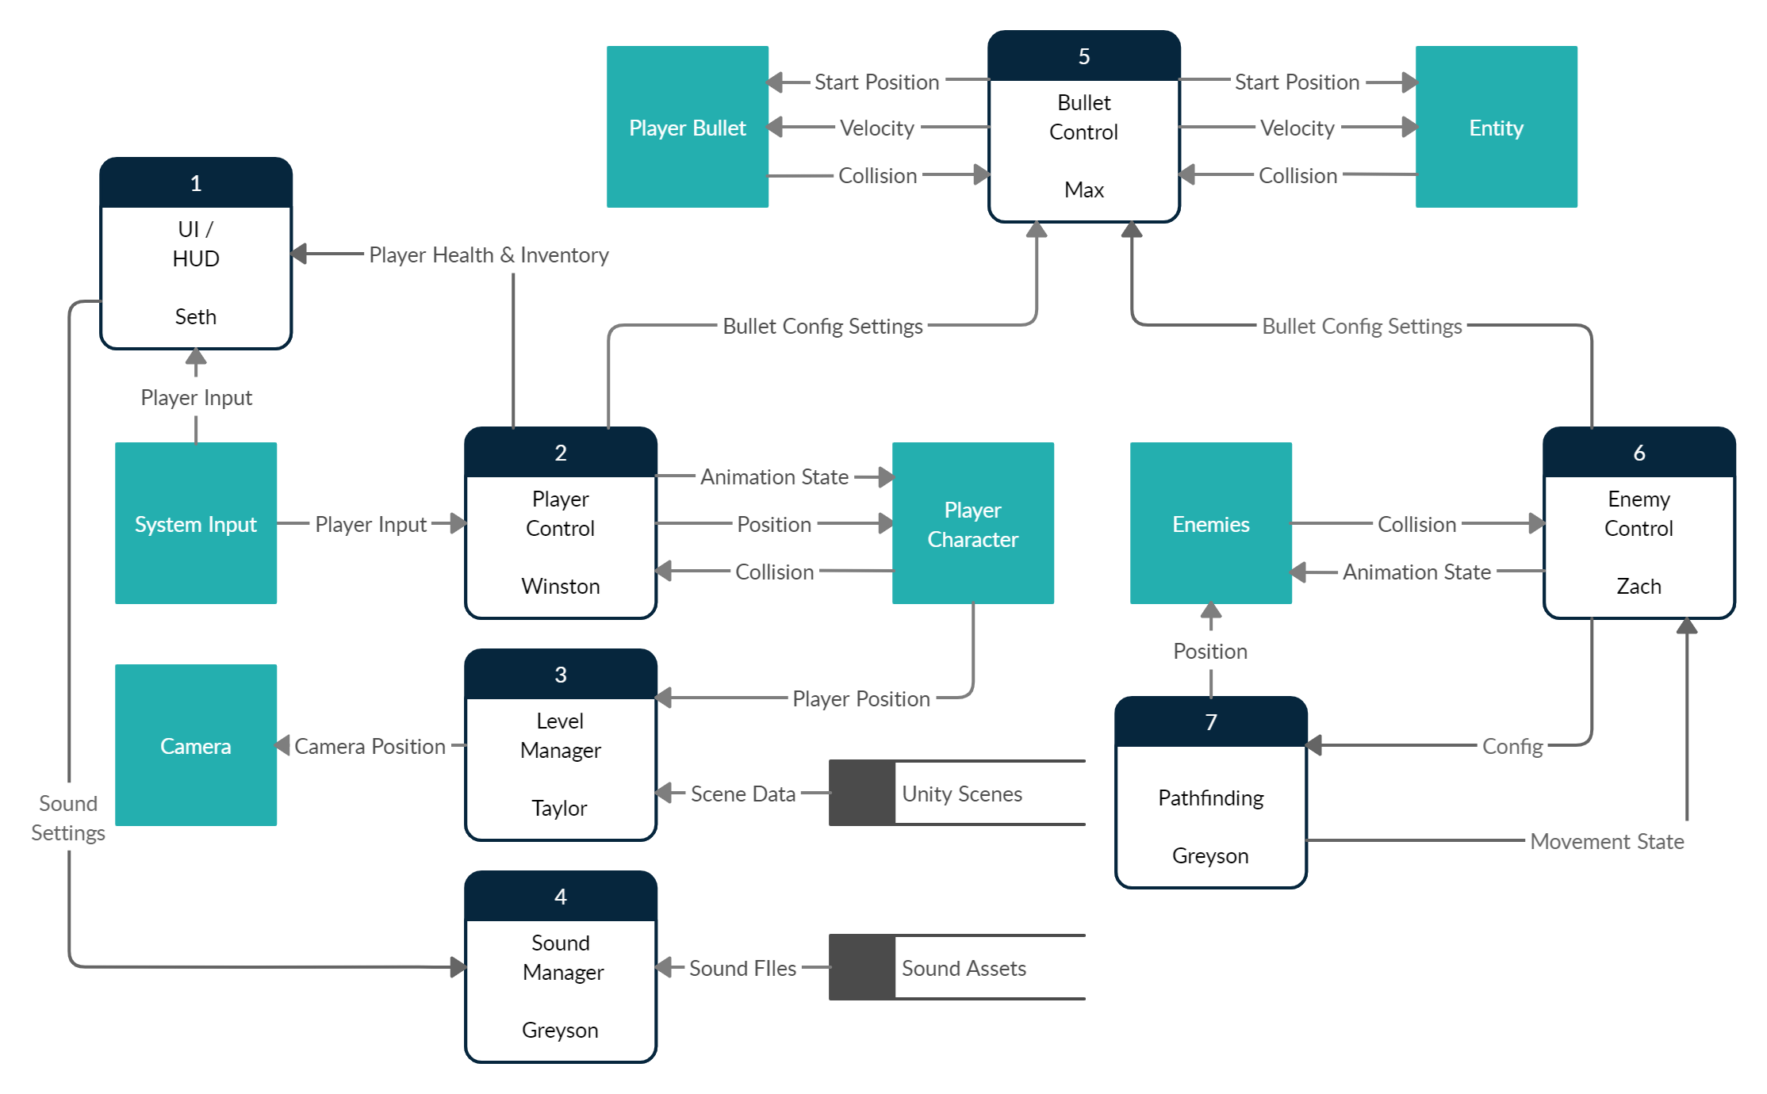
Diagram 0

Slide 13
Global Use Case Diagram
Developer Key:
Fiasco System Boundary
Player
Seth
Start Game
Read Note
Read instructions
Elicit Sound Effect
Kill Enemy
Taylor
Pause Game
Engage help menu
Adjust audio settings
Zach
Defeat Level 1 Enemies
Adjust difficulty
Clear Level 1
Strike enemy
Winston
Fight
Sustain damage
Max
Clear level 2
Defeat Level 2 Enemies
Move left
Provoke enemy behavior
Greyson
Move
Move right
Clear Level 3
Trigger pathfinding algorithm
Manage projectiles
Multiple
Defeat Level 3 Enemies
Move up
Claim Victory
Read end-of-game note
Move down

Slide 14
Individual Use Case - Seth
Fiasco UI/HUD
Player
Start Game
Read Note
Read Instructions
Pause Game
Adjust Difficulty
Decrement health when hit
Monitor Health
Display health on screen
Track Score
Increment score
Display score on screen
Claim Victory
Read victory note

Slide 15
Individual Use Case - Taylor
Fiasco Level Management
Player
Clear Level 1
Trigger Next Scene
Clear level 2
Load Level
Clear Level 3

Slide 16
Individual Use Case - Zach
9c2408
Fiasco Enemy Management
Player
Decrement enemy health
Adjust enemy animations
Stimulate Enemy Behavior
Track enemy deaths
Use pathfinding algorithm to plot path
Track enemy caused damage

Slide 17
Individual Use Case - Winston
Fiasco Player Control
Player
Move up
Move
Move down
Move left
Move right
Fight
Strike enemy
Pick up weapon

Slide 18
Individual Use Case - Max
Fiasco Projectile Control
Player
Apply pathfinding algorithm to bullet paths
Manage projectiles
Animate collisions
Create bullets

Slide 19
Individual Use Case - Greyson
Fiasco Pathfinding and Sound Management
Player
Adjust music audio
Select Audio Settings
Adjust sound effects audio
Dodge projectile patterns
Fight Enemies
Dodge enemy attack patterns

Slide 20
Questions?

